Slide 1
Introduction to Operating Systems
CPSC/ECE 3220 Spring 2020
Lecture Notes
OSPP Chapter 6 – Part A
(adapted by Mark Smotherman from Tom Anderson’s slides on OSPP web site)

Slide 2
Multi-Object Programs
What happens when we try to synchronize across multiple objects in a large program?
Each object with its own lock, condition variables
Is locking modular?
Synchronization performance
Eliminating locks

Slide 3
Synchronization Performance
A program with lots of concurrent threads can still have poor performance on a multiprocessor:
Overhead of creating threads, if not needed
Lock contention: only one thread at a time can hold a given lock
Shared data protected by a lock may ping back and forth between cores
False sharing: communication between cores even for data that is not shared

Slide 4
Synchronization Performance Topics
Multiprocessor cache coherence
MCS locks (if locks are mostly busy)
RCU locks (if locks are mostly busy, and data is mostly read-only)

Slide 5
Multiprocessor Cache Coherence
Scenario:
Thread A modifies data inside a critical section and releases lock
Thread B acquires lock and reads data
Easy if all accesses go to main memory
Thread A changes main memory; thread B reads it
What if new data is cached at processor A?
What if old data is cached at processor B?

Slide 6
Write Back Cache Coherence
Cache coherence = system behaves as if there is one copy of the data
If data is only being read, any number of caches can have a copy
If data is being modified, at most one cached copy
On write: (get ownership)
Invalidate all cached copies, before doing write
Modified data stays in cache (“write back”)
On read:
Fetch value from owner or from memory

Slide 7
Cache State Machine
Shared
(read-only)
Read miss
Peer write
Invalid
Peer read
Write hit
Write miss
Modified
(changed)
Peer write

Slide 8
Directory-Based Cache Coherence
How do we know which cores have a location cached?
Hardware keeps track of all cached copies
On a read miss, if held exclusive, fetch latest copy and invalidate that copy or mark as shared
On a write miss, invalidate all copies
Read-modify-write instructions
Fetch cache entry exclusive, prevent any other cache from reading the data until instruction completes

Slide 9
A Simple Critical Section
// A counter protected by a spinlock
Counter::Increment() {
while (TestAndSet(&lock))
;
value++;
lock = FREE;
memory_barrier();
}

Slide 10
A Simple Test of Cache Behavior
Array of 1K counters, each protected by a separate spinlock
Array small enough to fit in cache
Test 1: one thread loops over array
Test 2: two threads loop over different arrays
Test 3: two threads loop over single array
Test 4: two threads loop over alternate elements in single array

Slide 11
Results (64 core AMD Opteron)
One thread, one array | 51 cycles
Two threads, two arrays | 52
Two threads, one array | 197 (from contention)
Two threads, odd/even | 127 (from false sharing)

Slide 12
False Sharing
Diagram is from Tim Mattson, “A ‘Hands On’ Introduction to OpenMP,”
https://www.openmp.org/wp-content/uploads/Intro_To_OpenMP_Mattson.pdf

Slide 13
Reducing Lock Contention
Fine-grained locking
Partition object into subsets, each protected by its own lock
Example: hash table buckets
Per-processor data structures
Partition object so that most/all accesses are made by one processor
Example: per-processor heap
Ownership/Staged architecture
Only one thread at a time accesses shared data
Example: pipeline of threads

Slide 14
Linus Shares His Opinion
You seem to have this blue-eyed belief that locking is simple. It's not.
... you talk about the locking cost as if something like a 12-20 cycles is "free". That's pure [BS]. Even if it's uncontended, you're dirtying cachelines in the L1. Guess what? If you have finegrained locking for lots of objects, the cost of all that extra cache traffic is really bad, and takes up a valuable resource.
End result: very few people actually do fine-grained locking at all. It's damn hard, and it easily eats up 50%+ of your CPU cycles if you do it wrong. You spend years getting it right for anything but the most trivial case.
[from realworldtech.com, June 6, 2013]

Slide 15
Locking Design Issues
Fine-grained locking comes at a cost, however. In a kernel with thousands of locks, it can be very hard to know which locks you need—and in which order you should acquire them—to perform a specific operation. Remember that locking bugs can be very difficult to find; more locks provide more opportunities for truly nasty locking bugs to creep into the kernel. Fine-grained locking can bring a level of complexity that, over the long term, can have a large, adverse effect on the maintainability of the kernel.
Locking in a device driver is usually relatively straightforward; you can have a single lock that covers everything you do, or you can create one lock for every device you manage. As a general rule, you should start with relatively coarse locking unless you have a real reason to believe that contention could be a problem. Resist the urge to optimize prematurely; the real performance constraints often show up in unexpected places.
If you do suspect that lock contention is hurting performance, you may find the lockmeter tool useful. This patch (available at http://oss.sgi.com/projects/lockmeter/) instruments the kernel to measure time spent waiting in locks. By looking at the report, you are able to determine quickly whether lock contention is truly the problem or not.
From "Locking Traps," sec. 5.6 in J. Corbet, G. Kroah-Hartman, and A. Rubin, Linux Device Drivers, www.makelinux.net/ldd3/chp-5-sect-6

Slide 16
What If Locks are Still Mostly Busy?
MCS Locks
Optimize lock implementation for when lock is contended
RCU (read-copy-update)
Efficient readers/writers lock used in Linux kernel
Readers proceed without first acquiring lock
Writer ensures that readers are done
Both rely on atomic read-modify-write instructions

Slide 17
The Problem with Test and Set
Counter::Increment() {
while (TestAndSet(&lock))
;
value++;
lock = FREE;
memory_barrier();
}
What happens if many processors try to acquire the lock at the same time?
Hardware doesn’t prioritize FREE

Slide 18
The Problem with Test and Test and Set
Counter::Increment() {
while ( lock == BUSY || TestAndSet(&lock) )
;
value++;
lock = FREE;
memory_barrier();
}
What if many processors try to acquire the lock?
Lock value pings between caches

Slide 19
Test (and Test) and Set Performance
contention
similar to a broadcast wakeup
similar to a signal wakeup

Slide 20
Some Approaches
Insert a delay in the spin loop
Helps but acquire is slow when not much contention
Spin adaptively
No delay if few waiting
Longer delay if many waiting
Guess number of waiters by how long you wait
MCS
Create a linked list of waiters using CompareAndSwap
Spin on a per-processor location

Slide 21
Atomic CompareAndSwap
Operates on a memory word
Check that the value of the memory word hasn’t changed from what you expect
E.g., no other thread did CompareAndSwap first
If it has changed, return an error (and loop)
If it has not changed, set the memory word to a new value

Slide 22
MCS Lock
Maintain a list of threads waiting for the lock
Front of list holds the lock
MCSLock::tail is last thread in list
New thread uses CompareAndSwap to add to the tail
Lock is passed by setting next->needToWait = FALSE;
Next thread spins while its needToWait is TRUE
TCB {
TCB *next; // next in line
bool needToWait;
}
MCSLock {
Queue *tail = NULL; // end of line
}

Slide 23
MCS Lock Implementation
MCSLock::acquire() {
Queue ∗oldTail = tail;
myTCB−>next = NULL;
myTCB−>needToWait = TRUE;
while (!CompareAndSwap(&tail,
oldTail, &myTCB)) {
oldTail = tail;
}
if (oldTail != NULL) {
oldTail−>next = myTCB;
memory_barrier();
while (myTCB−>needToWait)
;
}
}
MCSLock::release() {
if (!CompareAndSwap(&tail,
myTCB, NULL)) {
while (myTCB−>next == NULL) ;
myTCB−>next−>needToWait=FALSE;
}
}

Slide 24
MCS In Operation (1)

Slide 25
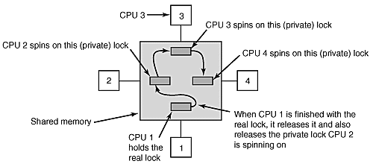
MCS In Operation (2)
Diagram from A.S. Tanenbaum, Modern Operating Systems, 2nd ed., as appears in A.S. Tanenbaum, “Multiprocessor Operating Systems,” InformIT, March 22, 2002, http://www.informit.com/articles/article.aspx?p=26027

Slide 26
Read-Copy-Update
Goal: very fast reads to shared data
Reads proceed without first acquiring a lock
OK if write is (very) slow
Restricted update
Writer computes new version of data structure
Publishes new version with a single atomic instruction
Multiple concurrent versions
Readers may see old or new version
Integration with thread scheduler
Guarantee all readers complete within grace period, and then garbage collect old version

Slide 27
Read-Copy-Update

Slide 28
Read-Copy-Update Implementation
Readers ask the kernel for scheduling priority on entry
Guarantees they complete critical section in a timely fashion
No lock needed
Writer
Acquire write lock
Compute new data structure
Publish new version with atomic instruction
Release write lock
Wait for time slice on each CPU
Only then, garbage collect old version of data structure

Slide 29
Progression of Reader/Writer Synchronization
RWLock
Recognize two types of access: read-only (“readers”) and update (“writers”)
API expands to four calls: startRead(), doneRead(), startWrite(), and doneWrite
Allow concurrent access by readers with exclusive access by writers
Appropriate substitute for a contended mutual exclusion lock when majority of accesses are reads

Slide 30
Progression of Reader/Writer Synchronization
RCU
Trade space for time by providing multiple versions of the data structure
Allow concurrent readers without acquiring a lock
Readers are not stopped during execution of a writer
Readers are instead given access to an older version of the data structure using the published pointer
Still requires startRead() and doneRead() system calls by readers
Thread scheduler prioritizes read accesses so that old versions of the data structure aren’t kept indefinitely
End of grace period can be determined

Slide 31
Non-Blocking Synchronization
Goal: data structures that can be read/modified without acquiring a lock
No lock contention!
No deadlock!
General method using CompareAndSwap
Create copy of data structure
Modify copy
Swap in new version iff no one else has
Restart if pointer has changed

Slide 32
Optimistic Concurrency Control
Allows overlapped execution of updates
With forward progress for at least one thread
If the updates apply to different fields in a protected object, then all can succeed
Gives benefit of fine-grain locking without all the locks
If same field is changed by another thread between the time a thread reads and writes, then write attempt fails and update has to be restarted using the new value
In essence, a critical section has been moved into the body of a busy wait loop

Slide 33
Lock-Free Bounded Buffer
tryget() {
do {
copy = ConsistentCopy(p);
if (copy->front == copy->tail)
return NULL;
else {
item = copy->buf[copy->front % MAX];
copy->front++;
} while (CompareAndSwap(&p, p, copy));
return item;
}

Slide 34
Comparison of Three Approaches
Spin lock
Queuing lock
Optimistic concurrency
test&set flag
critical
section
flag = 0
lock.acquire()
critical
section
lock.release()
read
update
cmp&swap succeeds
test&set spin
…
test&set flag
critical
section
flag = 0
lock.acquire()
read
update
cmp&swap
fails => read
update
cmp&swap
suceeds
critical
section
lock.release()
Second thread busy waits until successful test&set
Second thread calls acquire() and is put on the lock’s waiting list; it is put back on the ready list when first thread calls release()
Second thread fails on cmp&swap and then repeats the update using the new global value

Slide 35
CompareAndSwap ABA Problem
Intervening actions between copy and update of list head with reuse of an address
Needs a second word to act as a counter
IBM S/370 implemented a single-wide CS and double-wide CDS
Intel x86 implemented a single-wide CMPXCHG8B and double-wide CMPXCHG16B

Slide 36
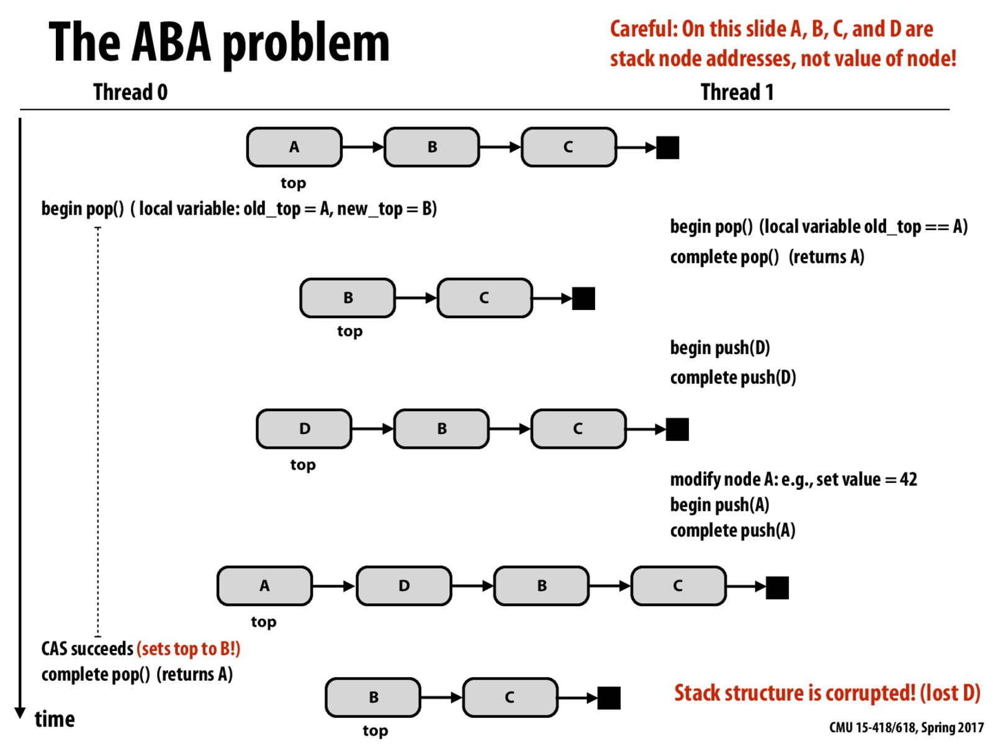
Diagram from http://15418.courses.cs.cmu.edu/spring2017/lecture/lockfree/slide_027

Slide 37
Hardware Transactional Memory
Execute without acquiring a lock and commit all writes at once
Track reads and writes of current processor and any interfering accesses from other processors at cache line granularity
If no interfering accesses, commit all updates in a single transaction
Otherwise abort and follow a non-transactional recovery path

Slide 38
Hardware Transactional Memory
Intel TSX (Transactional Synchronization Extensions)
HLE – Hardware Lock Elision
Prefix bytes added to instructions in legacy code
RTM – Restricted Transactional Memory
IBM z/Architecture TX (Transactional Execution)
Constrained transactions guarantee forward progress for at least one thread

Slide 39
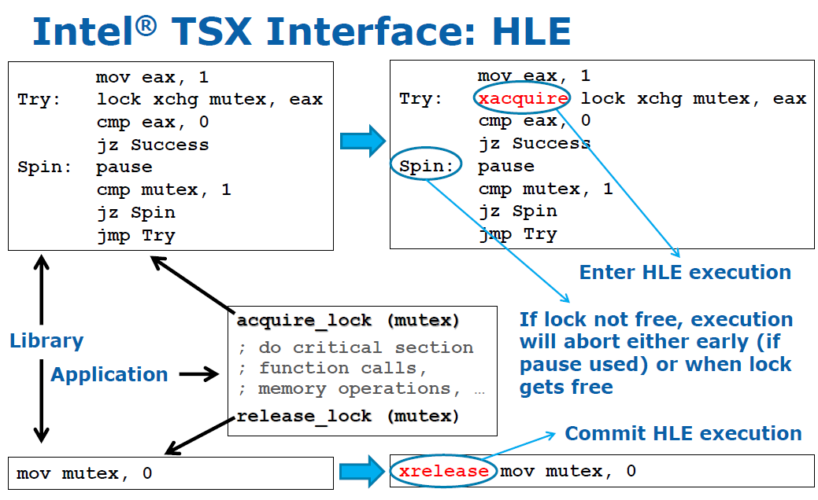
Slide from IDF 2012 presentation by Ravi Rajwar and Martin Dixon, as appears in Johan De Gelas and Cara Hamm, "Making Sense of the Intel Haswell Transactional Synchronization eXtensions," AnandTech, Sept. 20, 2012

Slide 40
Progression of Transactional Memory
CompareAndSwap instruction
Tests a value in a memory location
LoadLinked and StoreConditional instructions
Track interfering writes to a memory location
HW transactional memory
Tracks interfering accesses to cache lines

Slide 41
(if time permits)

Slide 42
Load Linked and Store Conditional
LL loads the addressed word from memory and places the address into a special register with which the processor bus-snoops
SC conditionally stores a word into memory
The address must be same as that loaded by the last LL
The store will succeed (i.e., modify memory and signal success) only if the location has not been modified since it was loaded by the LL
The processor is bus-snooping on this address, any writes from other processors to this address will be detected
The store will fail (i.e., not modify memory, signal failure) if the location has been modified since the LL or if the processor has context-switched
Success indicated by 1 in register; 0 otherwise
You can build higher-level synchronization constructs out of these primitives

Slide 43
LL/SC Example
// increment counter example – optimistic concurrency
// r1 points to counter
lp: ll r2,(r1) // load linked counter into r2
addi r3,r2,1 // r3 gets counter plus 1
sc r3,(r1) // conditionally update counter
beq r3,0,lp // test if sc successful
nop

